Slide 1
ECON 8320 Project
Noah Polacek

Slide 2
NIL Project
Goal: Collect and understand information of Name-Image-Likeness (NIL) deals.
Used the BeautifulSoup package to scrape a website for athlete information
https://nilcollegeathletes.com
Used Pandas to store and manipulate data
Used Plotly.express to create beautiful plots
Background

Slide 3
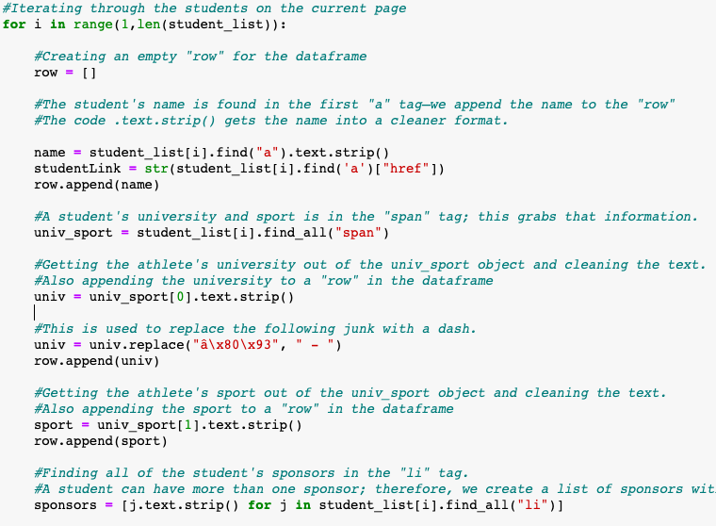
Web Scraper
Searched through all “tr” tags to get a list of students on the current page.
Gathered student’s name, university, sport, conference, and sponsors.

Slide 4
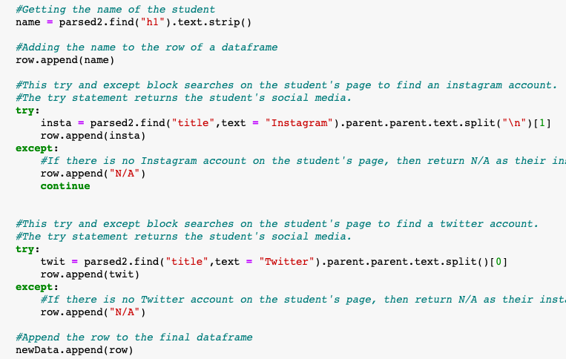
Web Scraper Continued
Crawled into each student’s subpage to get Instagram and Twitter accounts

Slide 5
Difficulties
Finding how to effectively use BeautifulSoup to scrape NIL data.
HTML code is hard…
Getting the plotly package to show exactly what was desired.
Did I mention the web scraper?

Slide 6
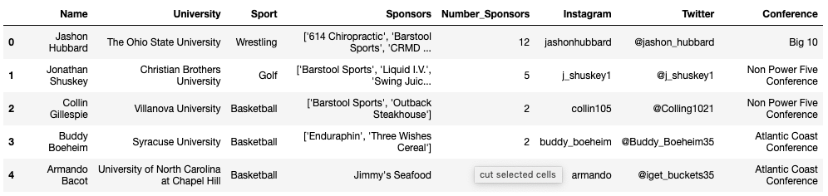
Results
Gathered the name, sport, university, sponsors, Instagram and Twitter accounts of 8,390 NIL-sponsored student athletes.
Did exploratory data analysis on the gathered data
Next slides have plots that explain findings.
First 5 rows of dataset

Slide 7
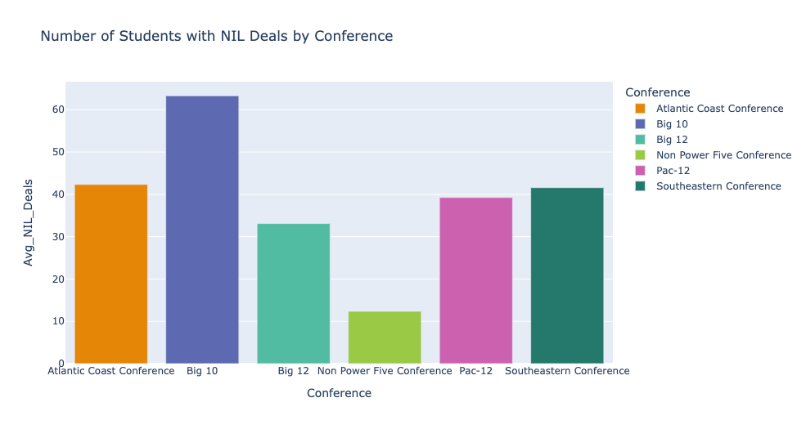
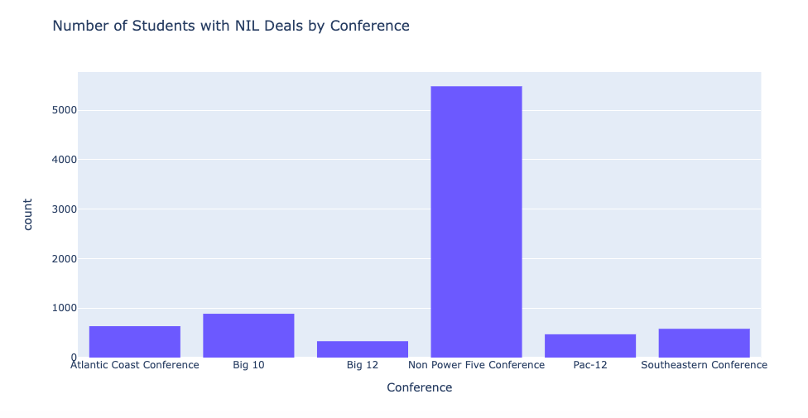
Non power five schools have majority of NIL deals, but the Big 10 has the most “per capita”

Slide 8
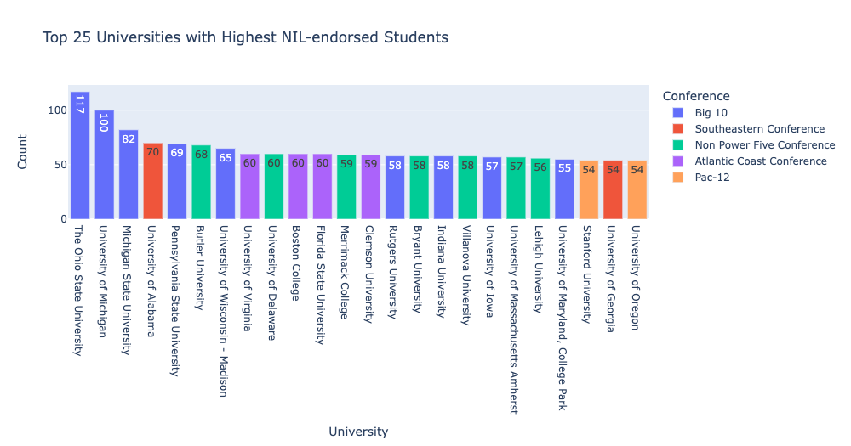
Big 10 best conference?

Slide 9
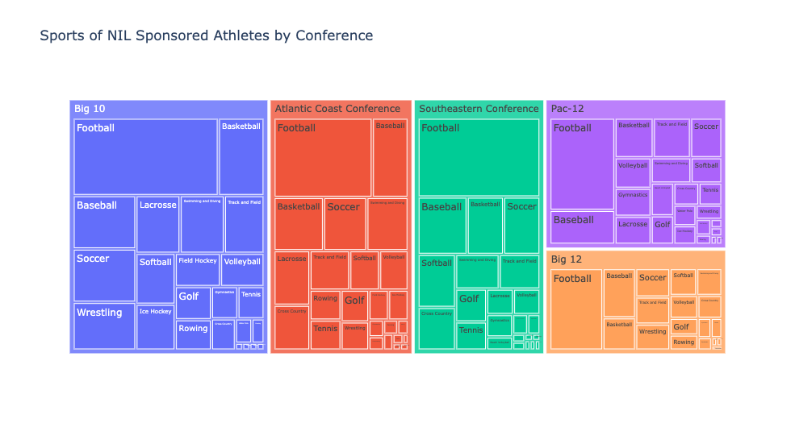

Slide 10
Questions?

